Slide 1
UI Basics 5
Guangjian Zhou

Slide 2
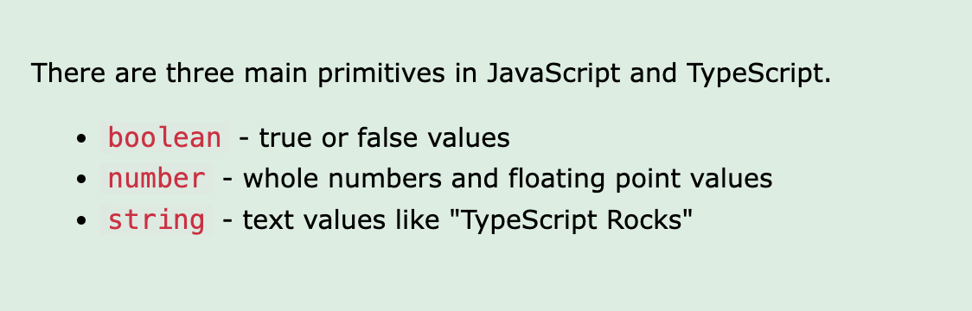
What are the primitive types in TypeScript?

Slide 3
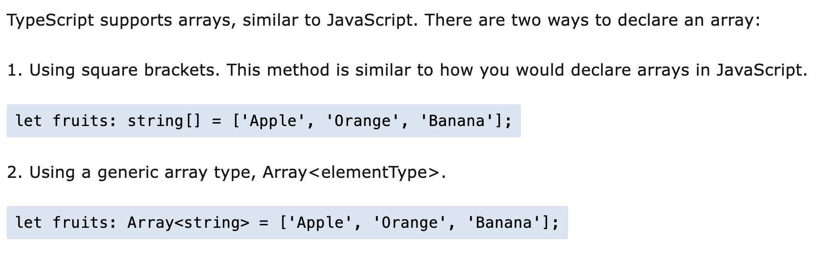
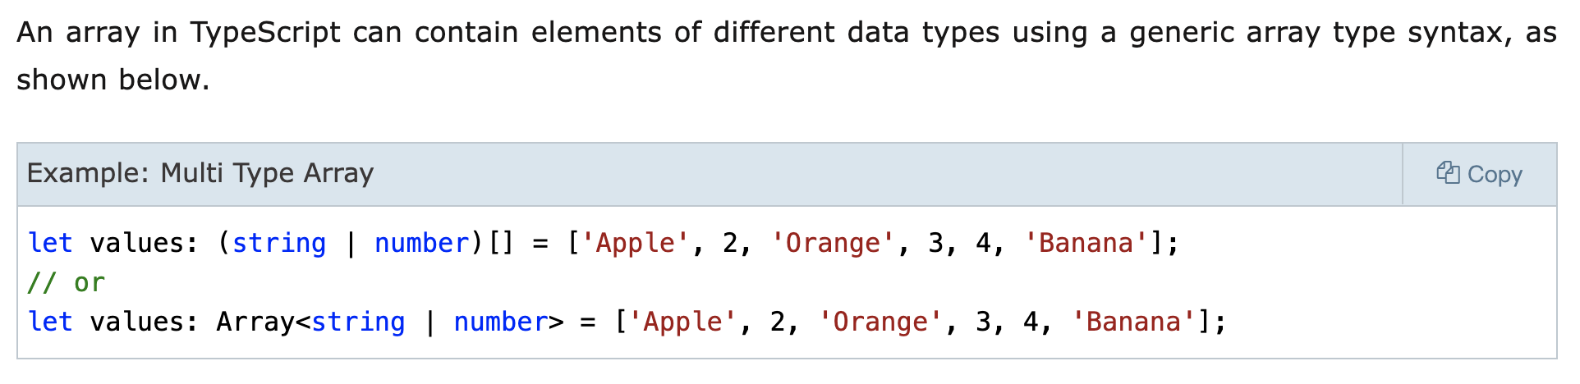
Explain how the arrays work in TypeScript.

Slide 4
What is any type, and when to use it?
It’s a common “easy-fix” to declare types as any, and through proper understanding of the type we can make the right decisions on when to use the any type.
The any type should really be used when we don’t actually know what type is actually coming back to us. This could be, for example, through a function argument that’s part of a third-party library and it doesn’t have any type definitions, as it could have been written in plain JavaScript and not TypeScript perhaps.

Slide 5
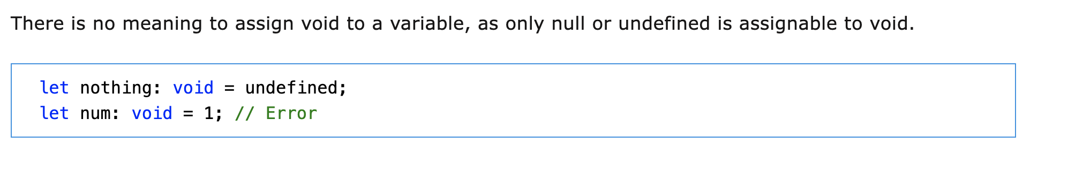
What is void, and when to use the void type?
Similar to languages like Java, void is used where there is no data.

Slide 6
What is an unknown type, and when to use it in TypeScript?
The main difference between unknown and any is that unknown is much less permissive than any: we have to do some form of checking before performing most operations on values of type unknown, whereas we don't have to do any checks before performing operations on values of type any.
The unknown type is only assignable to the any type and the unknown type itself. Intuitively, this makes sense: only a container that is capable of holding values of arbitrary types can hold a value of type unknown; after all, we don't know anything about what kind of value is stored in value.

Slide 7
What are the different keywords to declare variables in TypeScript?
In TypeScript, an extension of Javascript, there are three different keywords to define variables: var , let , and const .

Slide 8
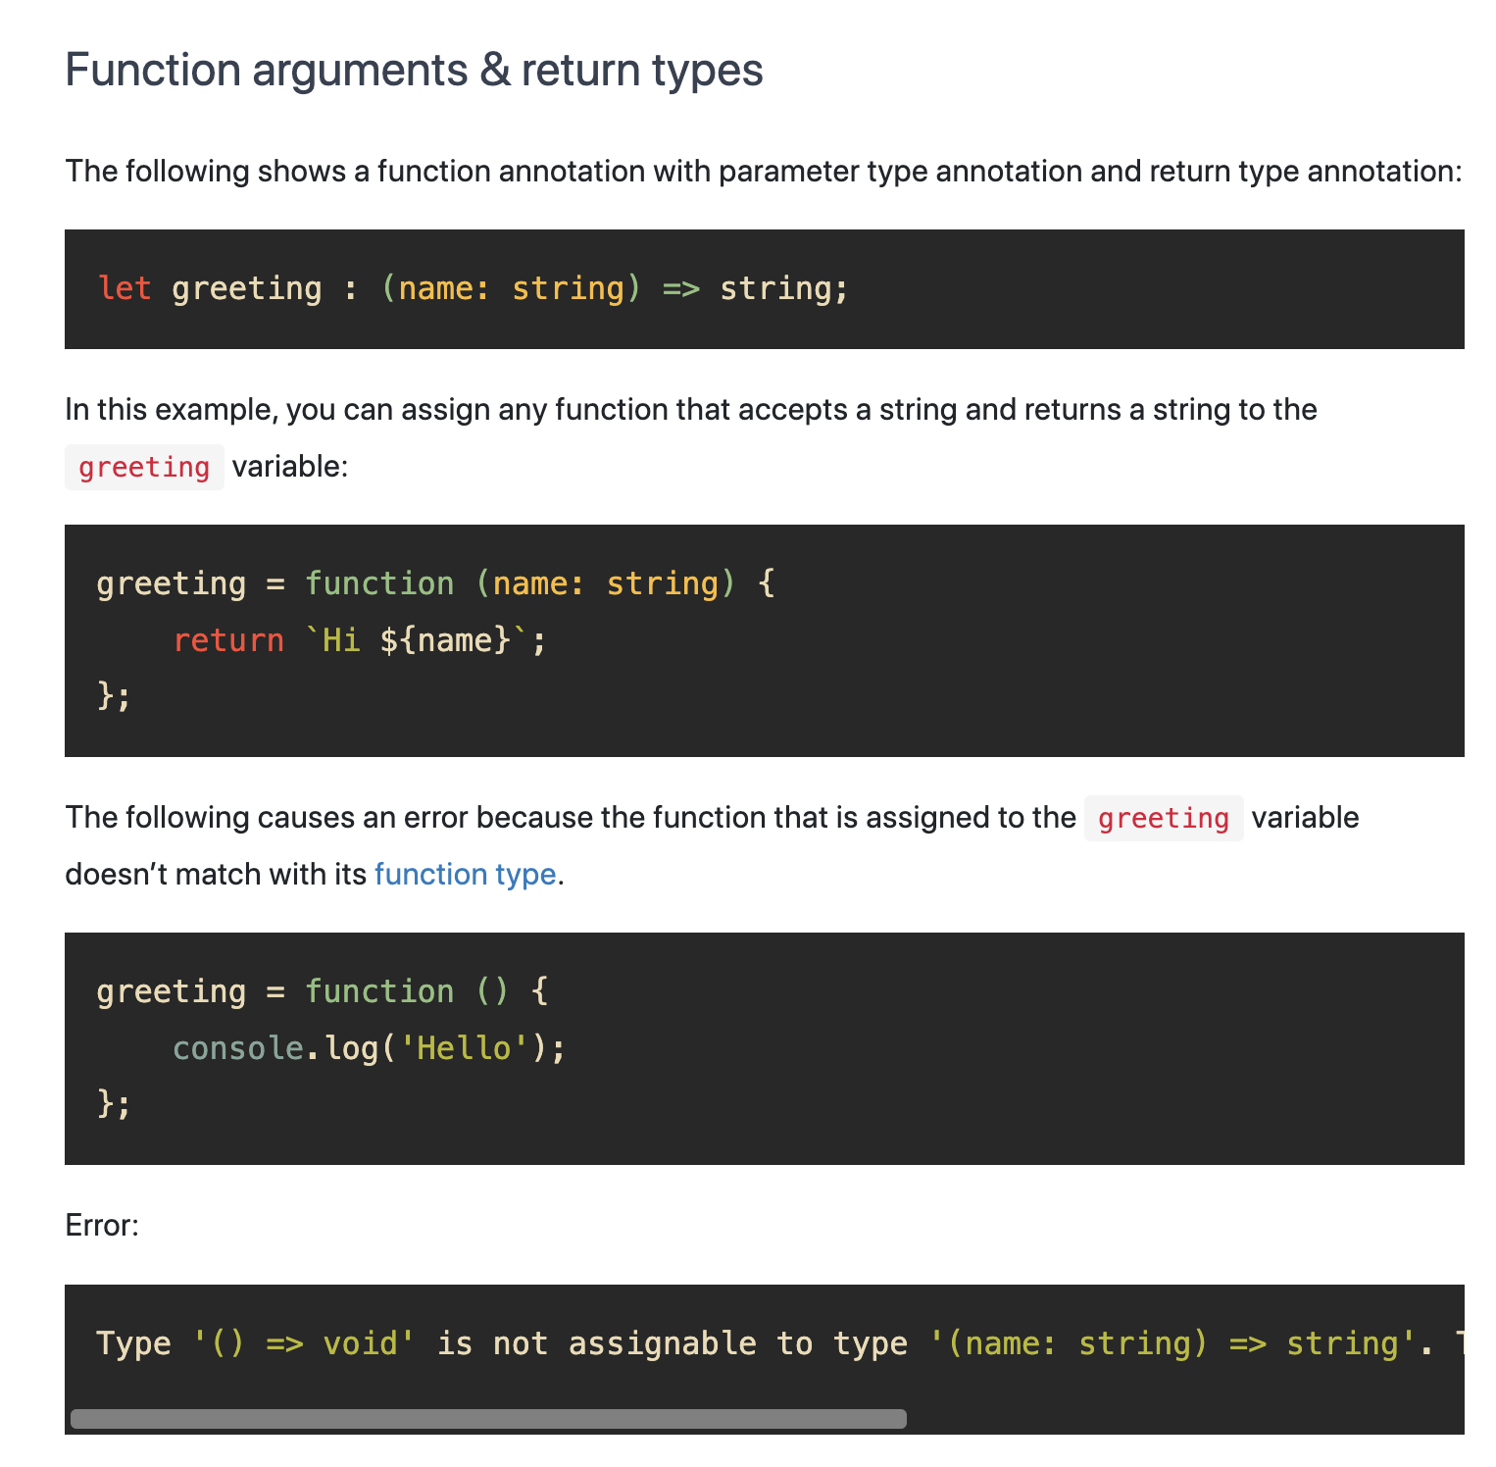
Provide the syntax of a function with the type annotations.

Slide 9
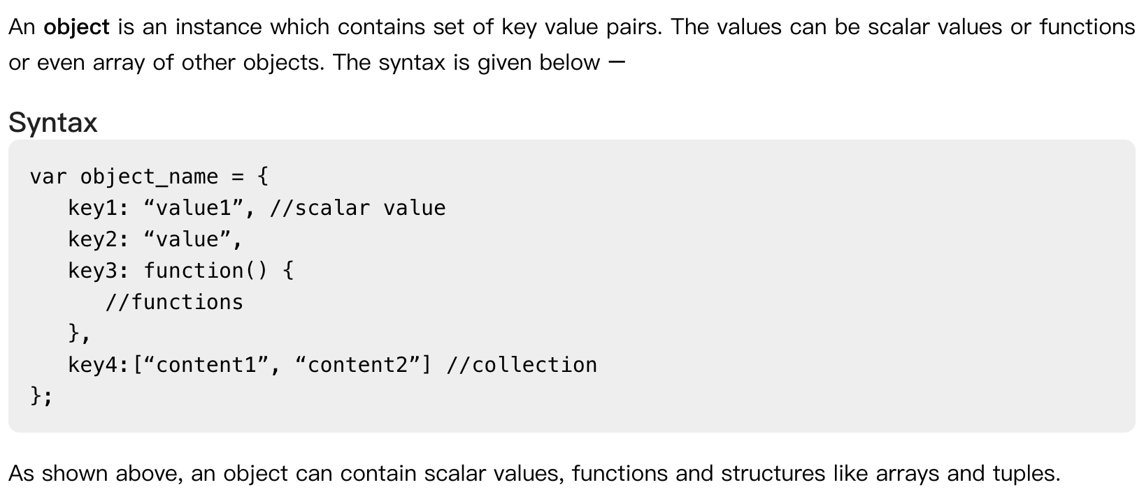
How to create objects in TypeScript?

Slide 10
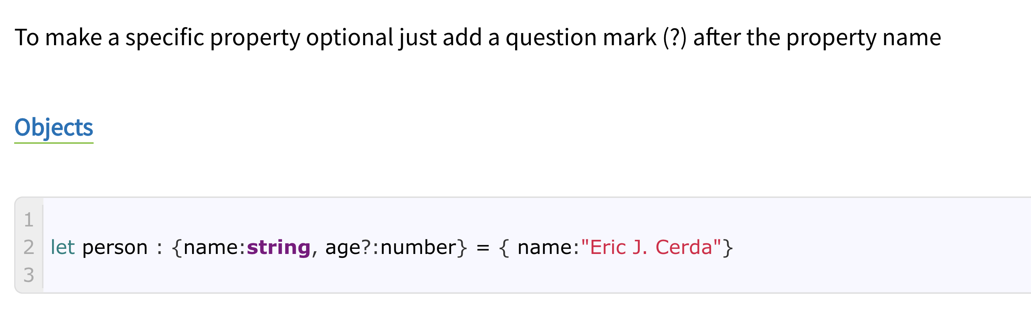
How to specify optional properties in TypeScript?

Slide 11
Explain the concept of null and its use in TypeScript.
In TypeScript, ‘null’ refers to the data type or value. The null is a keyword in TypeScript, which we can use to represent the absent or empty value. So, we can use ‘null’ to define the variable's data-type or initialize the variable.

Slide 12
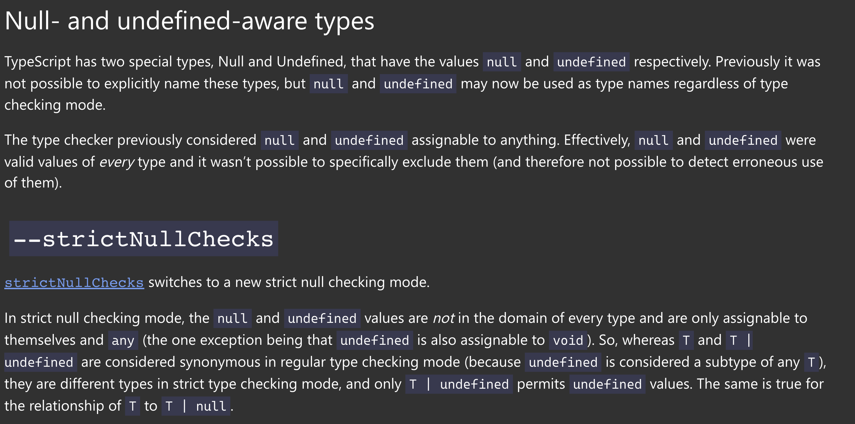
What is undefined in TypeScript?

Slide 13
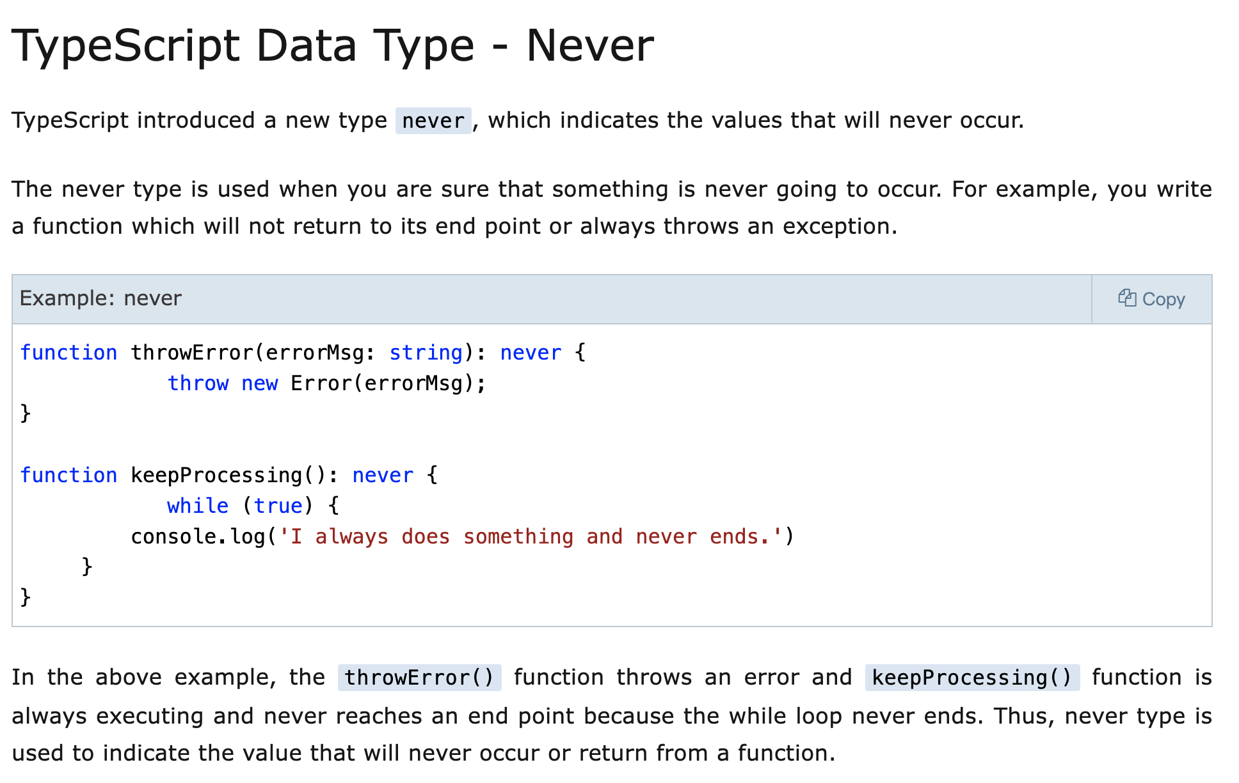
Explain the purpose of the never type in TypeScript.

Slide 14
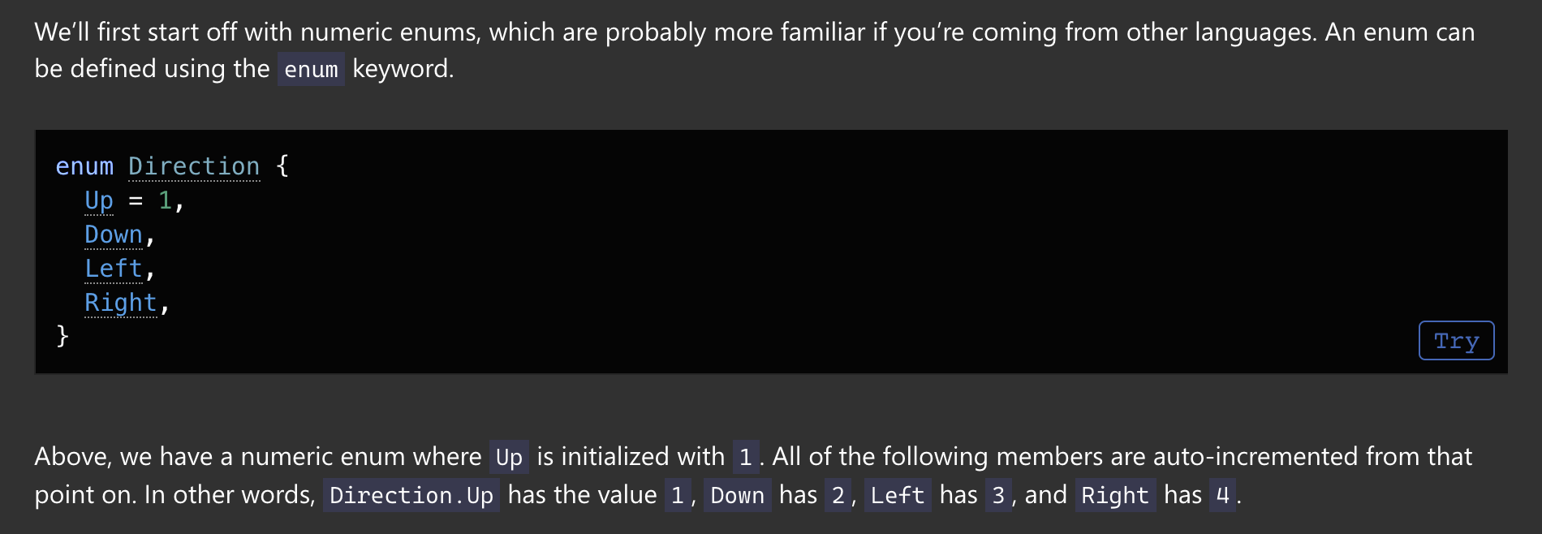
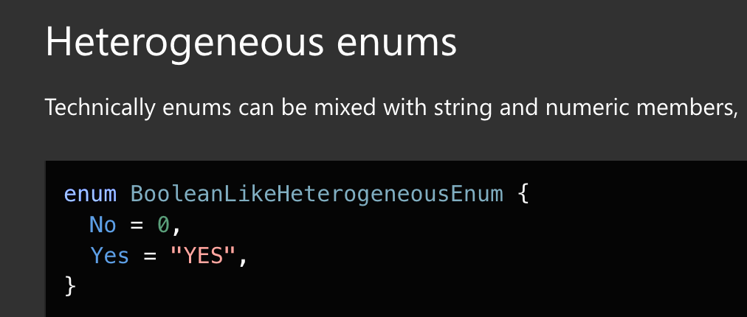
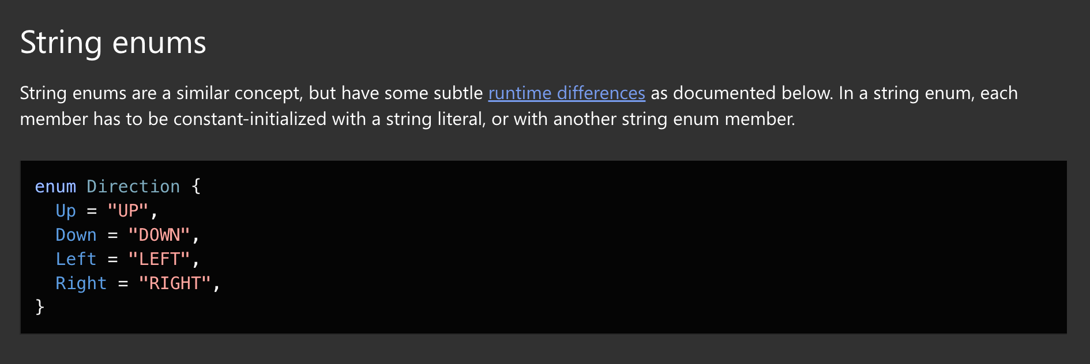
Explain how enums work in TypeScript?

Slide 15
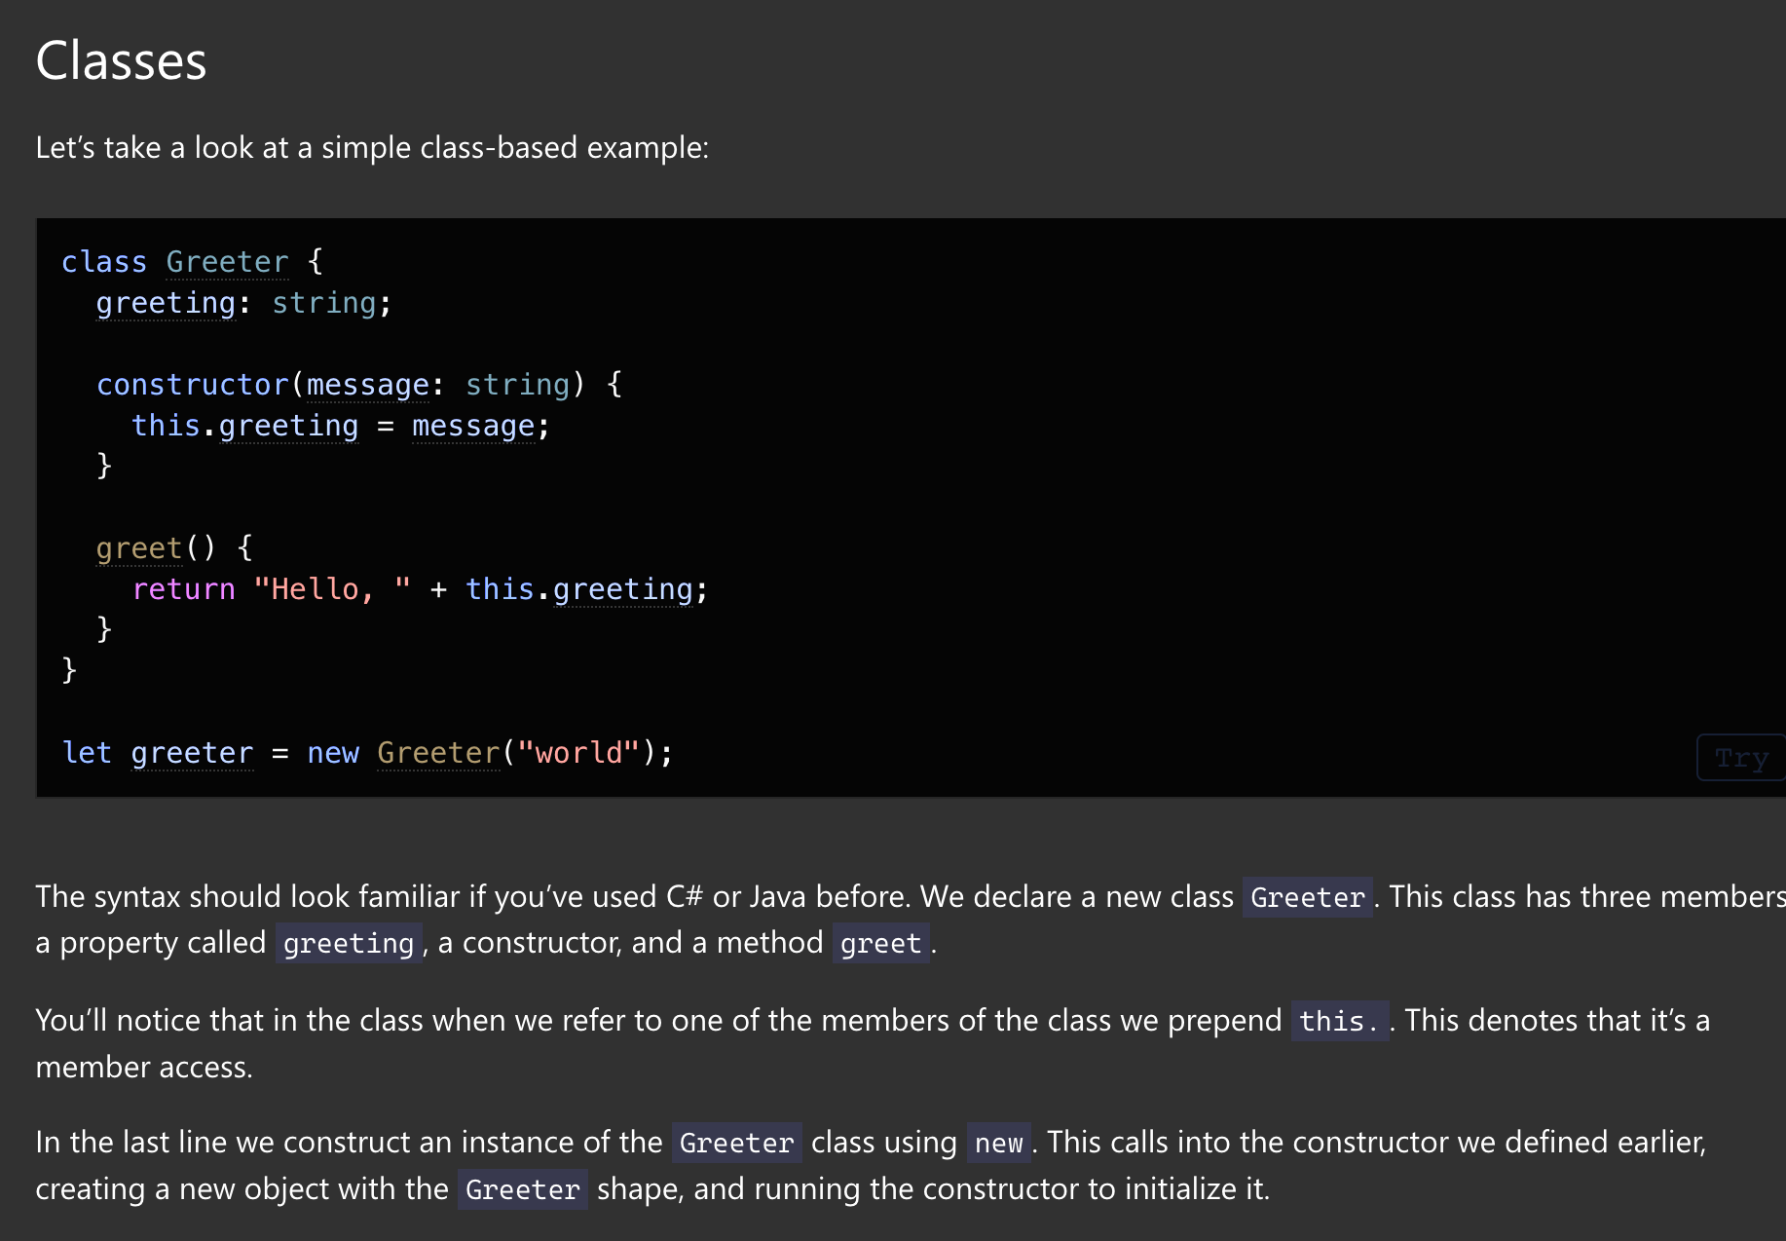
Explain the TypeScript class syntax.

Slide 16
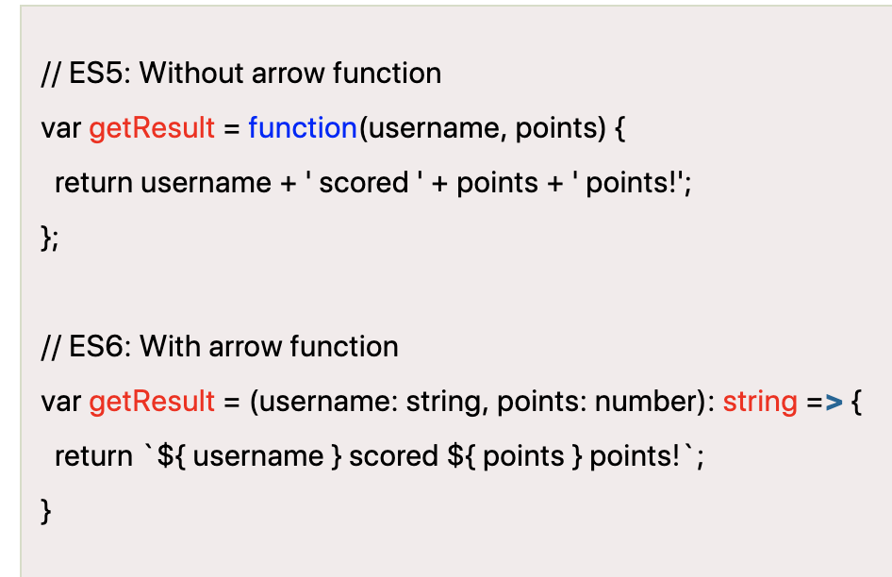
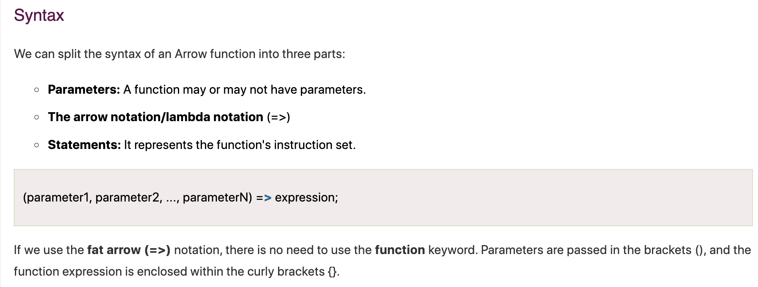
Explain the arrow function syntax in TypeScript.

